Slide 1
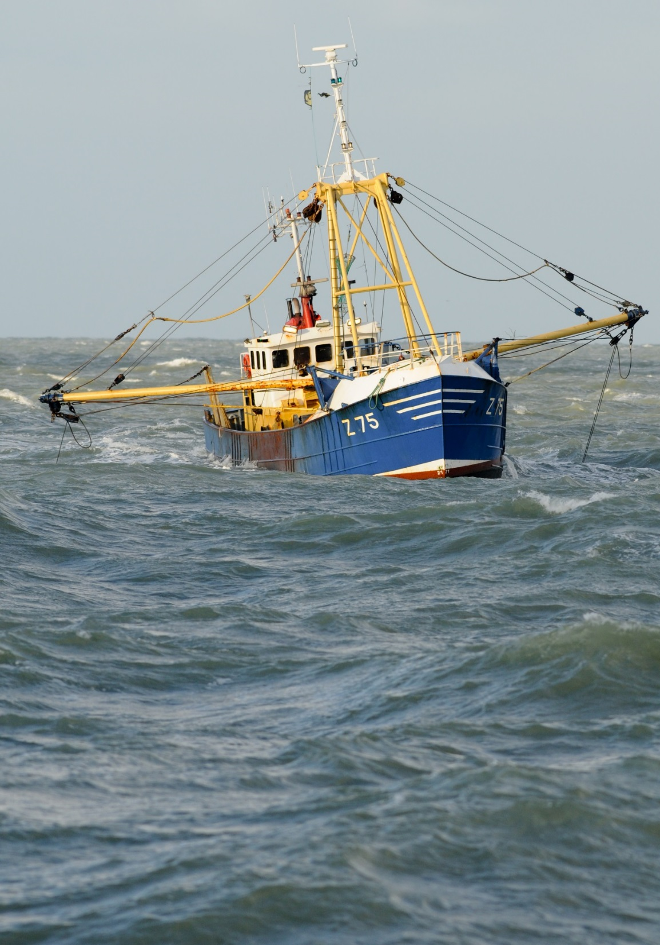





“Managing change in the Belgian fishery”
13 September 2016
CRISP meeting, Egersund
Arne Kinds, Kim Sys, Wim Allegaert, Lancelot Blondeel, Nicolas Derudder
VALDUVIS
An innovative way of assessing the sustainability of fishing activities
Notes:
Shale Rosen (IMR) invited us because there seems to be considerable interest from the Norwegian fishing industry in the assessment tool

Slide 2
This presentation?
The development of an indicator-based sustainability assessment tool, using real-time fishing data (e-logbook)
Development
Pilot
Implementation
Notes:
The question is: WHY this approach?

Slide 3
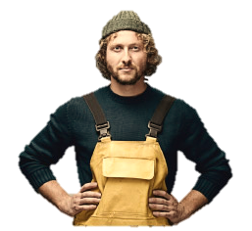
Objective
Assessing and visualizing sustainability in the Belgian fishery with the aim of valorizing sustainably caught fish.
Een instrument om de duurzaamheid van visserijactiviteit te meten en zichtbaar te maken
(!) 3 pillars of sustainability
(ecological, social, economic)

Slide 4
The Belgian fishery anno 2016
Total: 67 (active) vessels
Mixed demersal fishery (sole, plaice, brown shrimp, Nephrops)

Slide 5
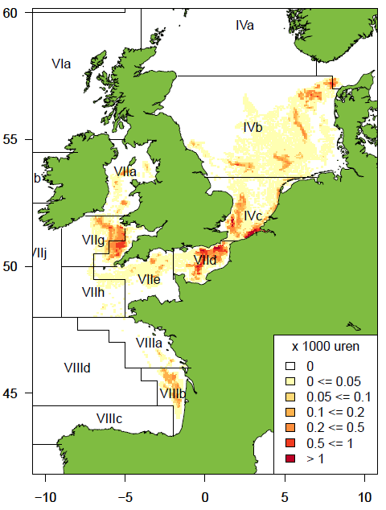
The Belgian fishery anno 2016
Not only diversity in gears, but also in fishing grounds
(VMS data 2013-2015)
North Sea (IVb and IVc)
English Channel (VIId,e)
Irish Sea (VIIa)
Bristol Channel and Celtic Sea (VIIf,g)
Gulf of Biscay (VIIIb)
Depending on experience, opportunity, weather, season, etc.
© Bart Vanelslander, ILVO

Slide 6
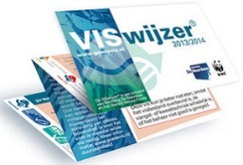
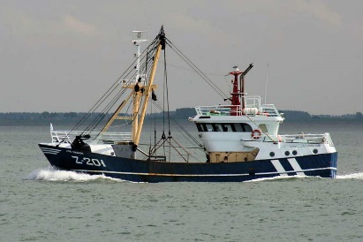
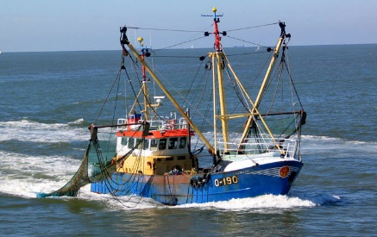
A fishery with a negative image
Negative perception of beam trawl
Low selectivity, sea bed disturbance, fuel-intensive
2009-2011
Retail made a sustainability commitment
  Belgian fishers risk losing market access if they cannot demonstrate best practices
Current assessment methodologies heavily criticized
Marine Stewardship Council (MSC) not considered option
Large vessel (Z 483)
2001; GT: 385 t; LOA: 37,81 m; 1630 HP
Medium-sized vessel (Z 201)
1996; GT: 139 t; LOA: 23,94 m; 300 HP
Coastal vessel (O 190)
1970; GT: 68 t; LOA: 22,32 m; 300 HP

Slide 7
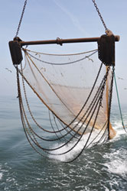
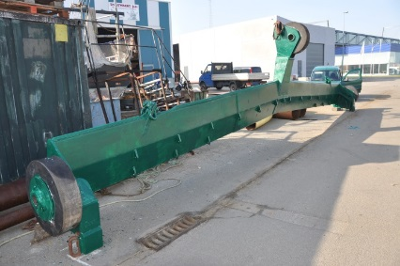
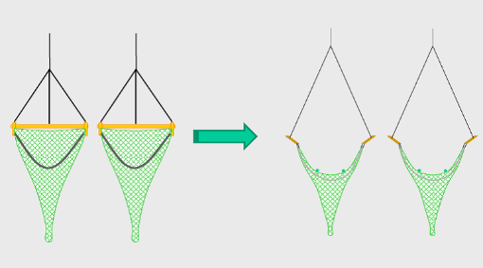
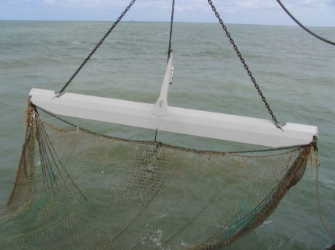
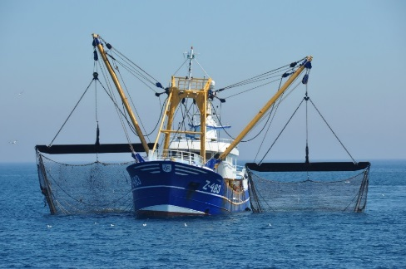
Towards sustainable fishing?
Traditional beam trawl
Alternative gears
Chain mat/tickler chains
Sumwing (NL, 2006), ecoroll beam (BE, 2011), twinrig,
↗ Selectivity
↘ Fuel consumption and bottom impact
Often developed by fishers or in science-industry partnerships
Demonstrate best practices!

Slide 8
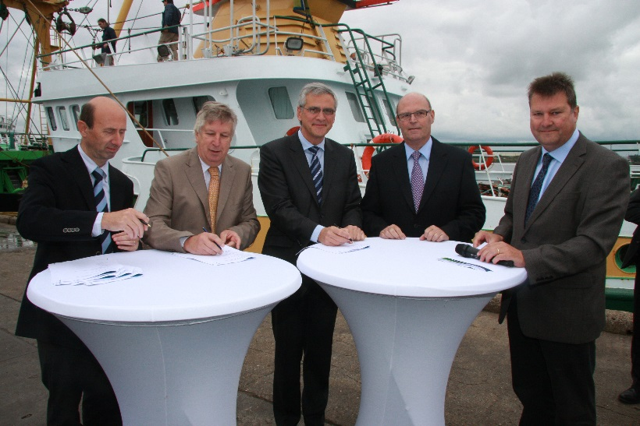
A change in attitude…
30 August 2011
The covenant for the promotion of a sustainable Belgian fishing
sector is signed
Notes:
Fishers hadn’t seen the need for a long time!
Under pressure from the market and the authorities, the PO decided to put sustainability on the agenda
Fishers’ producer organization (De Rederscentrale), an environmental NGO (Natuurpunt), the Flemish, Department for Agriculture and Fisheries and
the Institute for Agricultural and Fisheries Research (ILVO). The aim of this covenant was to initiate the transition of the Belgian fishery towards sustainability.
In this context, ILVO was asked to develop an indicator-based assessment tool for measuring and monitoring the sustainability of the Belgian fishing fleet.

Slide 9
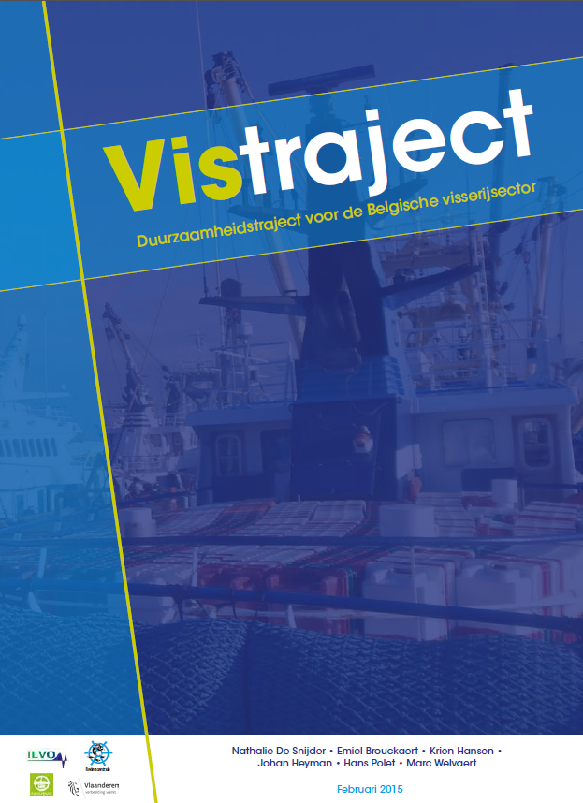
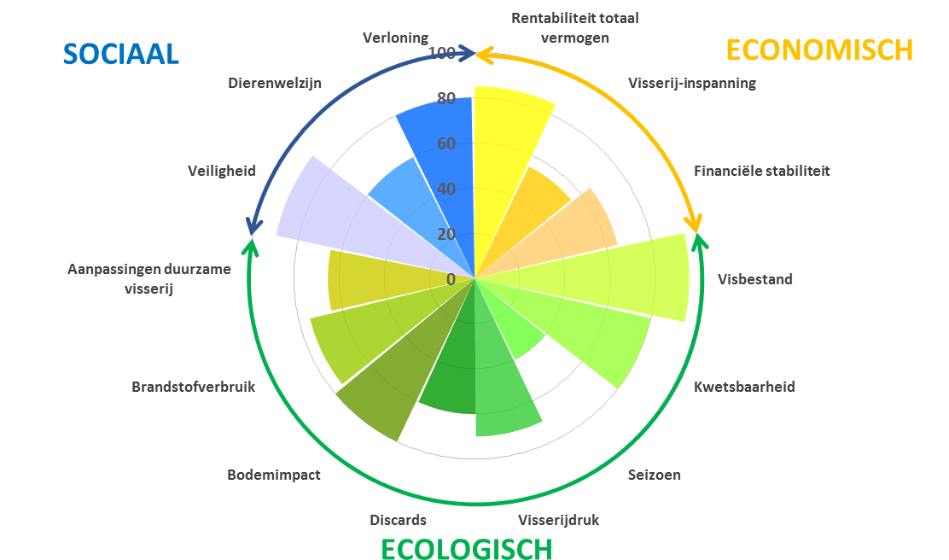
Two new projects
Vistraject
VALDUVIS
Goals and actions for a sustainable fishery by 2020
Indicator-based sustainability assessment tool
Notes:
The Producer Organization
The Department fot Agriculture and Fisheries
The Institute for Agricultural and Fisheries Research (ILVO)
An environmental NGO (Natuurpunt)
The VISTRAJECT project (2011-2014)
‘A trajectory towards sustainability in the Belgian fishery’
Develop shared vision of a sustainable future
Define sustainability goals and actions
Promoters: government, NGOs, PO, research institute
The VALDUVIS project (2011-2014)
Develop indicator-based sustainability monitoring tool
Multi-use tool, tailored to needs of different end users

Slide 10
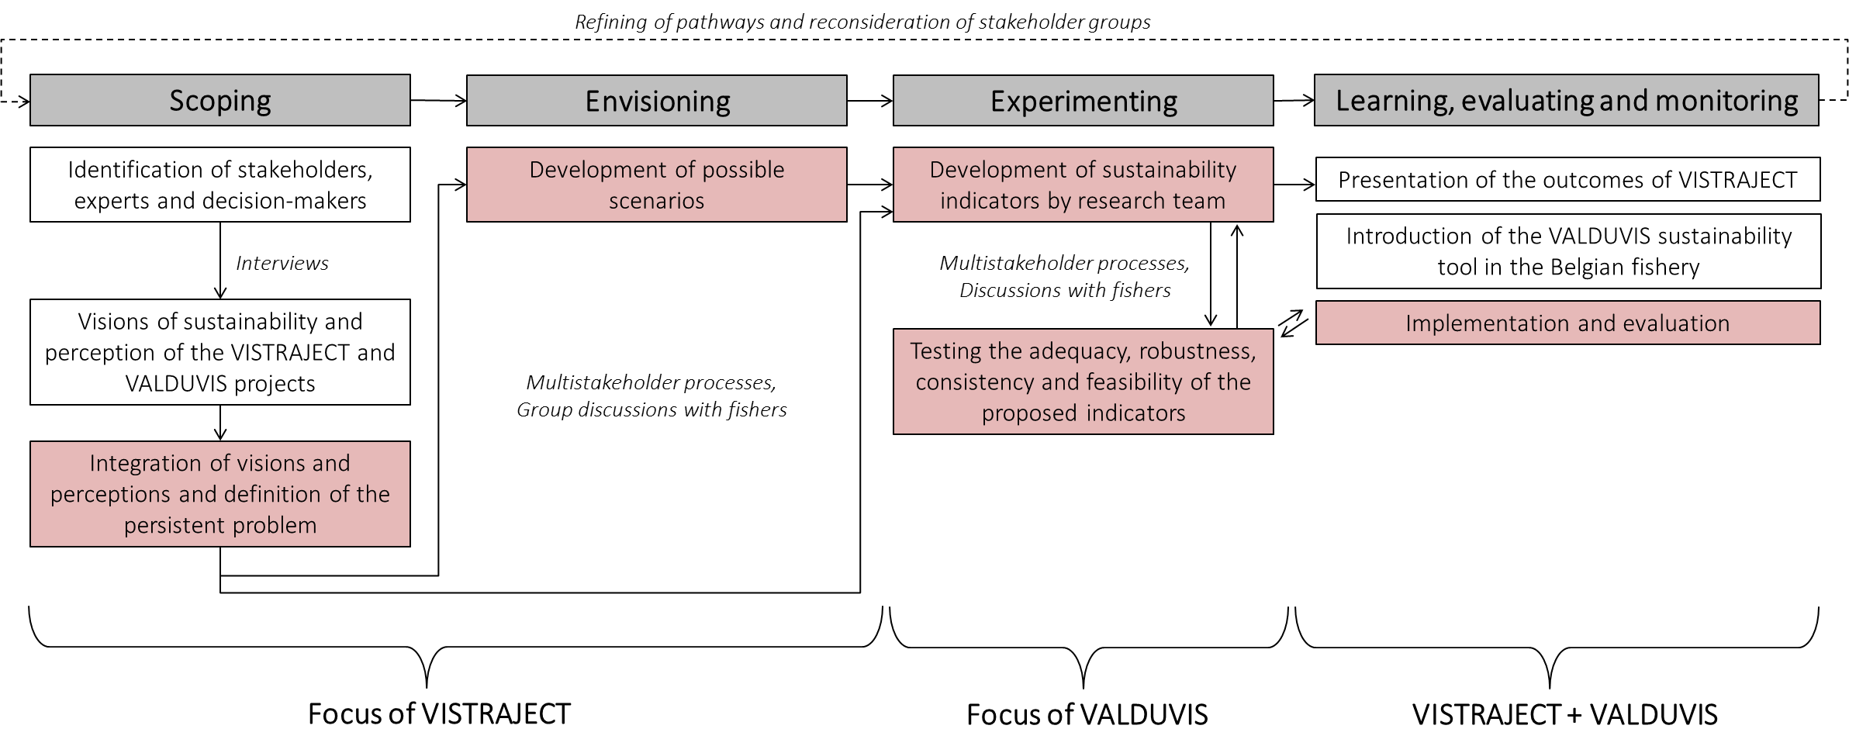
Framework
Integrated Sustainability Assessment (see Weaver and Rotmans 2006)
Initiate transition towards sustainability
  Cyclic step-by-step approach
  Stakeholder participation is key
Kinds et al. (2016), Fisheries Research
Notes:
INCLUDE ALL STAKEHOLDERS THROUGHOUT THE PROCESS
Uitleg Focus Groups etc.

Slide 11
The assignment
  Tool to assess, visualize and monitor the sustainability of the Belgian fishing fleet
Individual assessments
  Provide fishers with insight into their sustainability
Monitoring
  Measure progress towards sustainability goals (VISTRAJECT)
Market
  Recognize efforts on the market
Notes:
This newly developed tool can be used for monitoring the progress of the fleet towards sustainability and should at the same provide fishers insight into the sustainability of their own actions and choices in relation to their colleagues.
Zie verder: pragmatisch, ontstaan uit een noodzaak, een rechtstreekse vraag

Slide 12


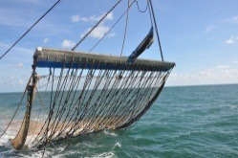
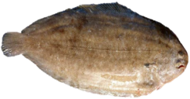
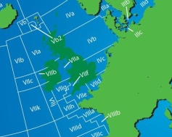
Why individual assessments?
  Fishing tactics vary greatly between fishers
    + no fishing trip is the same!
  High degree of detail at a relatively low cost
  Near real-time information (!)
  Multiple opportunities
    Learning tool
    Monitoring (cfr. VISTRAJECT)
    Market tool
  Electronic Reporting System (ERS) = underused!
  Detailed data for each fishing trip
  A multi-level, multi-use instrument
Notes:
(support from sector): LEARNING TOOL
WAAROM GEEN MSC?
Monitoring: in plaats van algemene indicatoren over de vloot te berekenen, gebruiken we individuele assessments om iets over de duurzaamheid van de hele vloot te kunnen zeggen

Slide 13
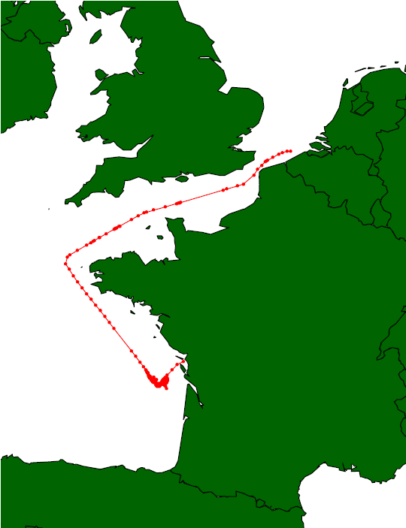
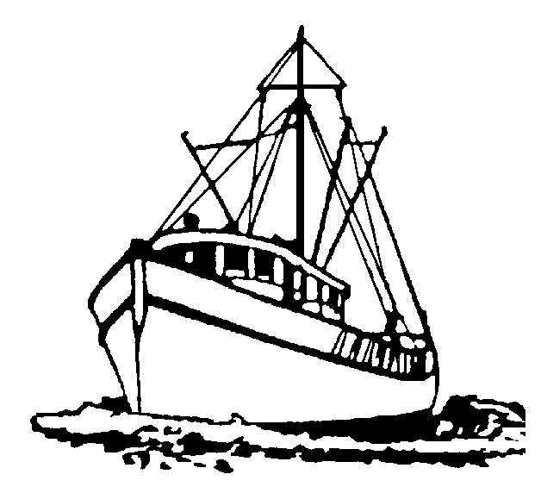
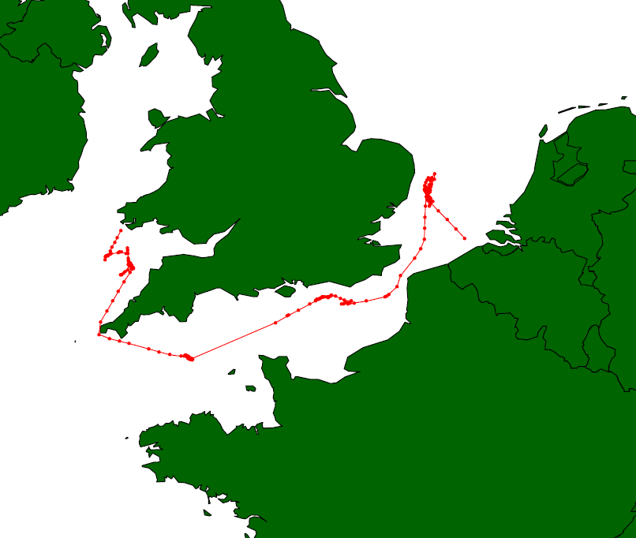
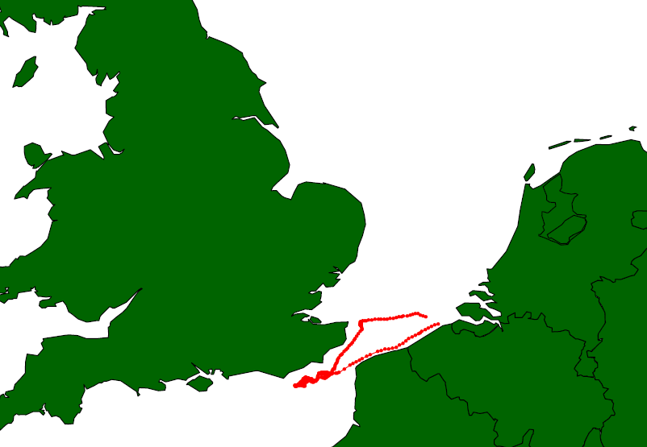
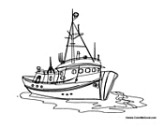
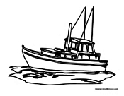
How does it work?
Trip
Vessel
Segment
4 levels
Fleet
Notes:
Hier moet duidelijk zijn dat er twee vragen zijn waar VALDUVIS op inspeelt

Slide 14
Visual presentation
Case study: beam trawler, inshore fishing vessel, <221 kW
Notes:
Economisch, sociaal, ecologisch

Slide 15
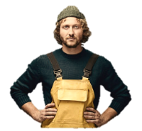
Step-by-step implementation
Three applications:
①
Individual assessments
  Learning tool for fishers
②
Monitoring progress towards collective goals
  Monitoring tool
③
Develop a market application for VALDUVIS
  Market application
  Increasing threshold for participation!
Notes:
Bij begin van deze slide normaal nog niet gepraat over automatisatie

Slide 16
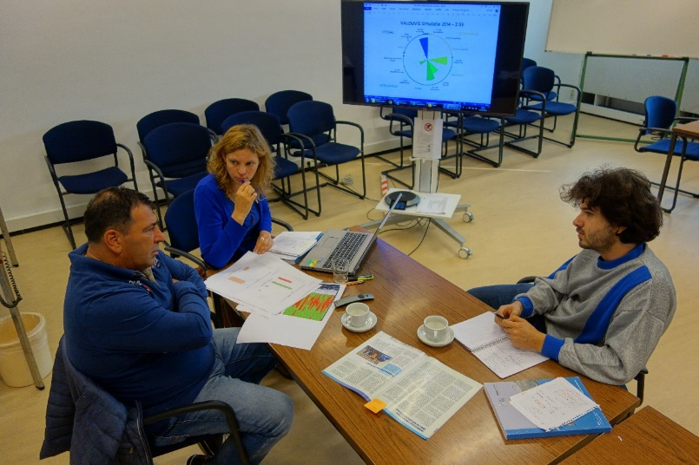
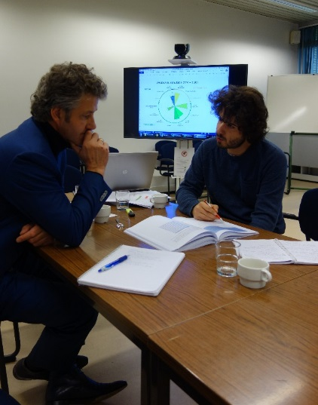
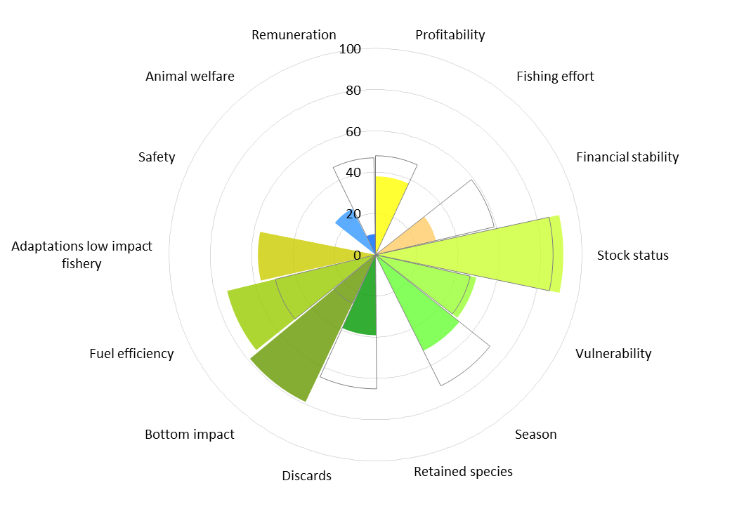
Step-by-step implementation
①
Individual assessments
  Learning tool for fishers
2015: pilot testing on 4 vessels
Test use on board (effort for fisher, data transfer)
Data validation
Automation (scoring algorithm) and real-time scoring
2016: finalize learning tool and implement it for all vessels; develop toolbox for improvement
Notes:
Bij begin van deze slide normaal nog niet gepraat over automatisatie

Slide 17
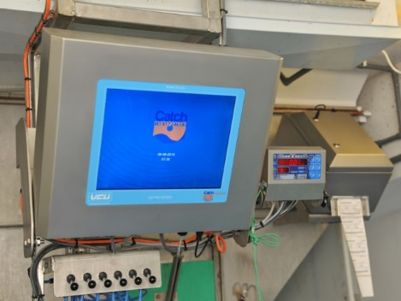
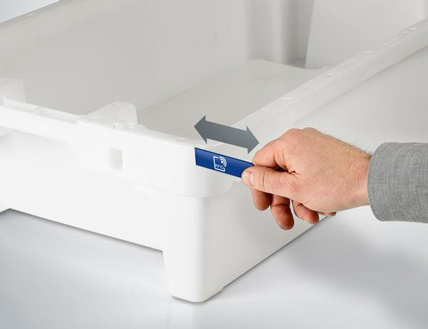
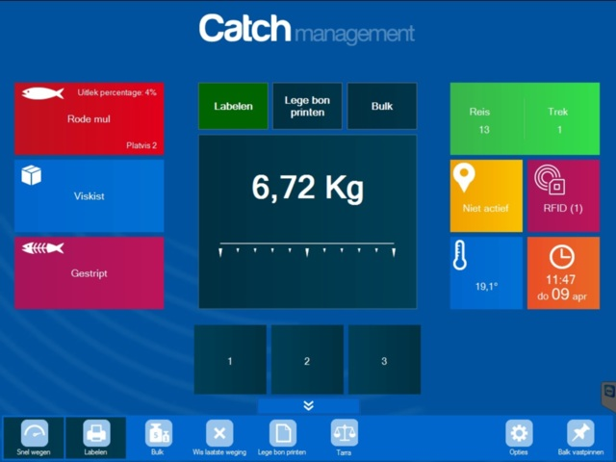
Traceability (Z.483)
RFID technology
Notes:
Andere vragen
- Adriatic Sea = Real-time quota monitoring?

Slide 18

User interface (learning tool)
https://valduvis.be/Login?returnurl=%2f
Notes:
INCLUDE ALL STAKEHOLDERS THROUGHOUT THE PROCESS

Slide 19
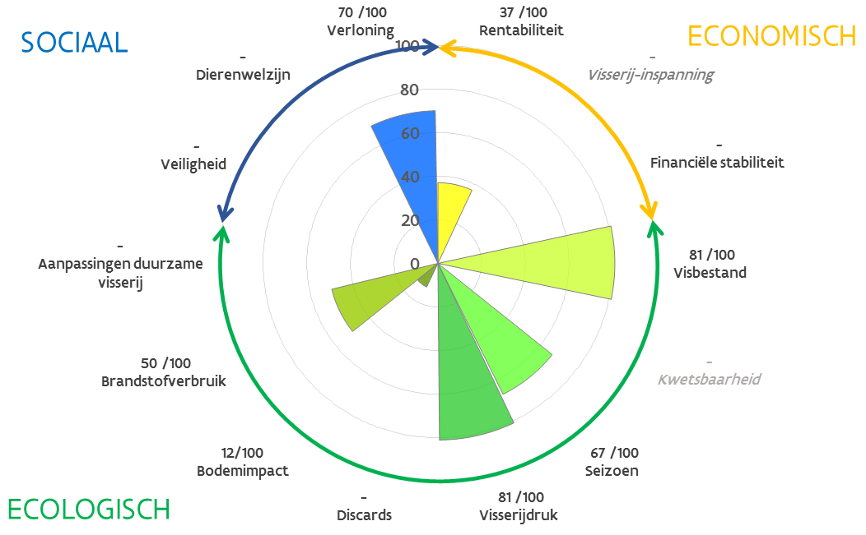
Step-by-step implementation
②
Monitoring progress towards collective goals
  Monitoring tool
Formalize the use of VALDUVIS as a monitoring tool
  E.g.; indicator “fuel consumption per euro fish is reduced by 10% by 2020”
Data exploration through cluster analysis
Define fisher profiles for each indicator (~métier approach)
Reference values and thresholds
e.g. what can be expected from each profile (group efforts, individual efforts)
Notes:
Zeggen wat monitoring nu is!!!!!!!!!! Slides vallen weg wegens te veel

Slide 20

Step-by-step implementation
③
Develop a market application for VALDUVIS
  Market application
  Scope is still unclear due to varying priorities
    Label?
    Fisheries Improvement Program (FiP) endorsed by retail?
    Individual vs. collective?
    Sustainable fish or sustainable fisheries?
    Link with MSC?
    Visualization on auction clock?
  … now inclided toward label, busy defining thresholds
?
Notes:
This was the main incentive from the beginning!

Slide 21
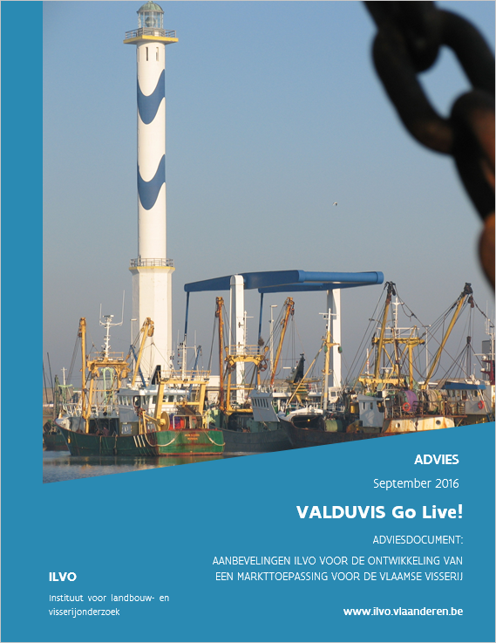
Market application
  Market application = needed (but what should it look like?)
ILVO suggested two thresholds for each indicator:
T_{minimum}
T_{strict} (T_{label})
Notes:
This was the main incentive from the beginning!

Slide 22
Market application
Aggregated score >= T_{label}
  Label
Public, voluntary
T_{minimum} < aggregated score < T_{label}
  Fisheries Improvement Program
Public, voluntary
  Learning, monitoring
Anonymous, for all vessels
Notes:
This was the main incentive from the beginning!

Slide 23
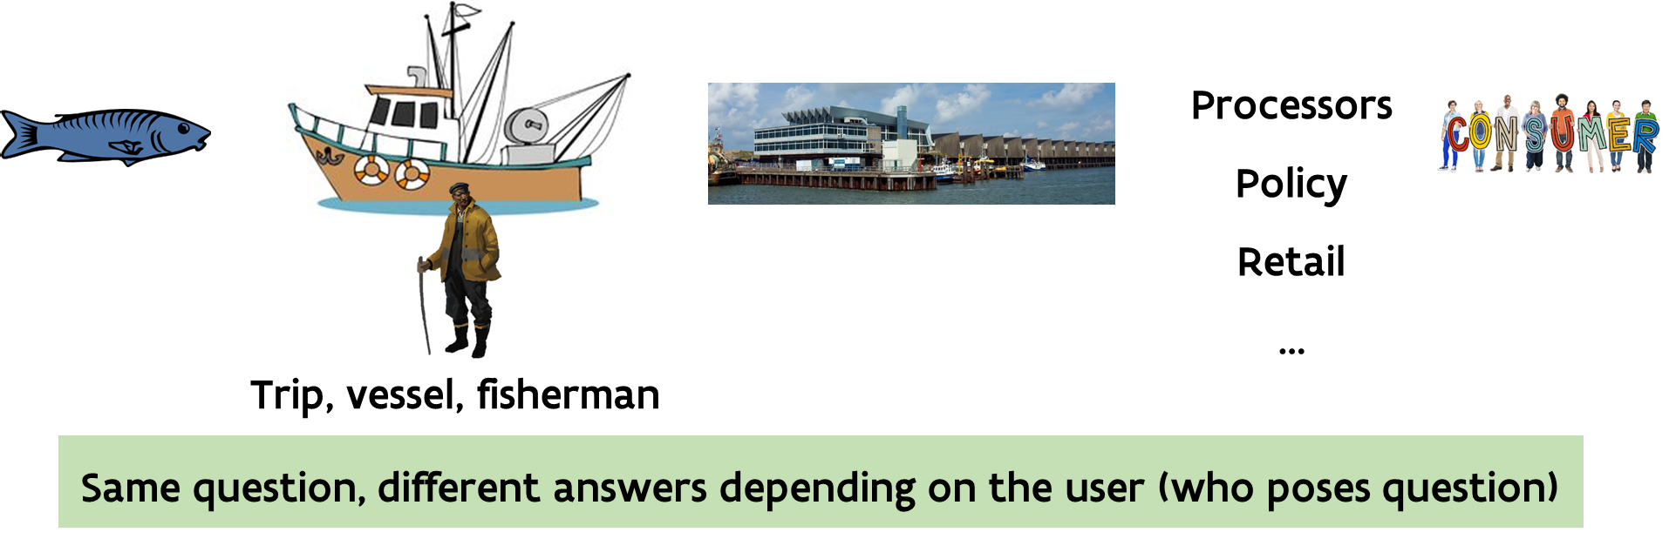
Application in Norway?
  Demonstrating best practices on export market?
  Internal monitoring tool (compare vessels in terms of discards, fuel efficiency, etc.)?
  Self-assessment tool?
  …
Notes:
This was the main incentive from the beginning!

Slide 24
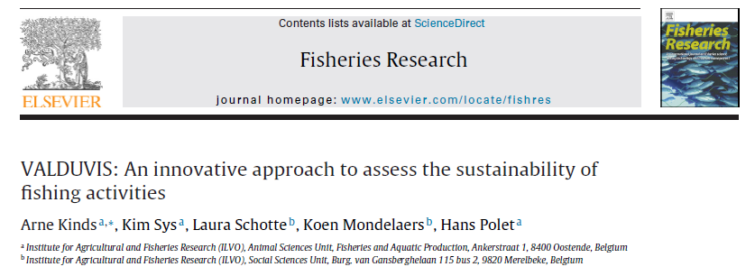
Want to know more?
Kinds et al. (2016), Fisheries Research
Methodology can be found online (only in Dutch)
https://valduvis.be/Publicaties
Notes:
Zeg dat je niet verder zal ingaan op de details, maar dat je bereid bent om achteraf uit te leggen
METHODOLOGIE achter elk van de indicatoren: formules, berekeningen

Slide 25



Thank you!
Arne Kinds
arne.kinds@ilvo.vlaanderen.be
+32 59 56 98 26
Kim Sys
kim.sys@ilvo.vlaanderen.be
+32 59 56 98 54
Nicolas Derudder
nicolas.derudder@ilvo.vlaanderen.be
+32 59 56 98 03
Lancelot Blondeel
Lancelot.blondeel@ilvo.vlaanderen.be
+32 59 56 98 97

Slide 26
Stakeholder participation
Participatory processes
Multistakeholder process
Fishers’ cafés
Stakeholders
Feedback, adaptations, approval
Feedback, adaptations, approval
Feedback, adaptations, approval
Time
Researchers
Analysis
Analysis
Analysis
Scientific study
MSP I: Traceability
MSP III: Indicators
4 steering group meetings
MSP II: Themes
MSP IV: Applications
Build relationships w/ fishers

