Slide 1
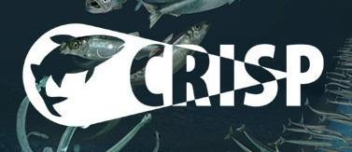
The effect of operational procedures on the catch quality in the Barents Sea bottom trawl fishery for cod (Gadus morhua)
Jesse Brinkhof
14.09.2016

Slide 2
Introduction
3-year PhD-position
Employed at the Norwegian College of Fishery Science, University of Tromsø
The main objective:
“To document the effect of various trawl components as well as operational procedures, with the aim of improving the quality of the catch caught by Norwegian bottom trawlers in the Barents sea”

Slide 3
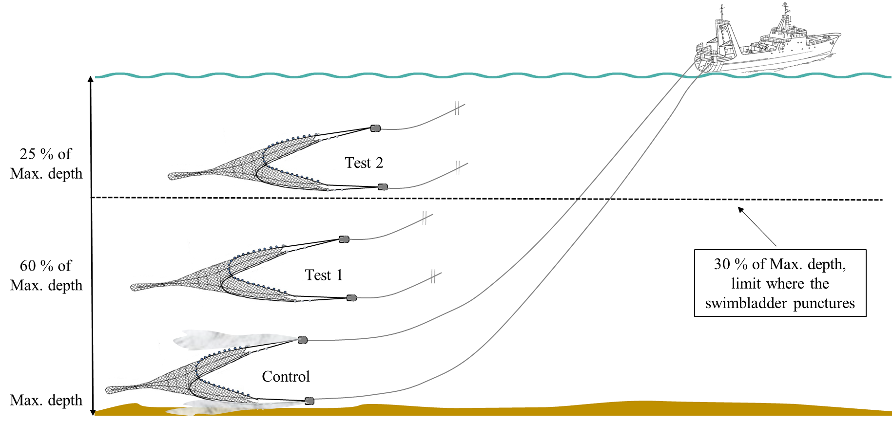
Study I: Assessing the impact of prolonged buffer towing on the quality of the catch
Prolonged buffer towing (towing the trawl in the water column) is a method used for securing a constant supply of fish to the onboard factory.
However, this practice is believed to have negative consequences on the quality of the catch.
Trails will be conducted onboard R/V “Helmer Hanssen” during November 2016.

Slide 4
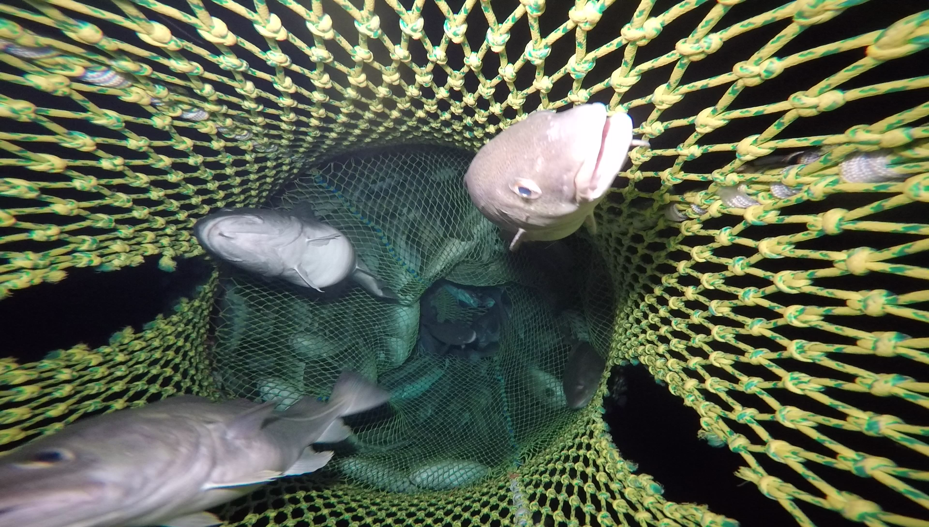
Study II: Documenting the effect of excessive fish exclusion devices (ExFED) on the catch quality
Comparing the quality of the catch caught with and without the use of a ExFED.
The ExFED limits the expansion of the catch during haul-back, and is thus believed to increase the amount of damage to the catch, with subsequent reduction in quality.
Source: IMR

Slide 5
Study III: Improving the catch quality using a “haul-back” codend opened at depth with a inverse hydrostatic release mechanism
The lack of expansion possibility when using a ExFED, as well as hauling the catch directly onboard are believed to cause damage to the catch with subsequent reduction in catch quality.
Therefore, an new codend will be designed with the purpose of preserving the catch quality by reducing the mechanic pressure during haul-back.
The codend will be opened during haul-back using a inverse hydrostatic release mechanism, resulting in additional space for expansion as well as reduction in exposure to gravity while hauling up the slipway.

