Slide 1
ISAC Perspectives on CRISP: Now & Post-2019
Steve Walsh, DFO Canada, Petri Suuronen, FAO Rome and Sveinn Margeirsson, MATIS Iceland

Slide 2
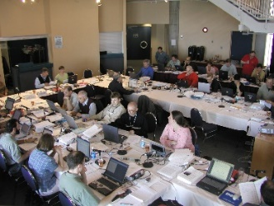
Outline
ISAC Terms of Reference
Our present perspective of CRISP
Our perspective for the future: post 2019

Slide 3
ISAC’s mandate:
Provide non-binding strategic advice to CRISP Board of Directors to ensure scientific quality of the research and to improve CRISP’s national and international visibility and reputation.

Slide 4
ISAC’s mandate (cont’d):
In particular we are concerned with:
The quality of research and its relevance for commercial operations;
The level of collaboration across partners and the degree to which synergies are being leveraged;
The appropriateness of methods and approaches that are employed in the different WPs;
The effectiveness of the organization and management structure; and
The degree to which the Center is able to foster new ideas and to fuel innovation.
Notes:
We will update our perspective and report to the Board by end of September; comments on 2017 workplan by November

Slide 5
As we now see CRISP -INNOVATIONS
Norway is probably the only country with the resources to undertake a project like CRISP.
Many CRISP scientists have a strong international network of contacts.
CRISP technological partners are nationally respected and several are internationally recognized.
The amount of technological developments (15 as of Dec 2015) covering WP1-5, some with scientific value others with commercial value or both, is outstanding and will greatly enhance value adding in many ways.
Notes:
It is a great example of Science and industry collaboration model

Slide 6
As we now see CRISP -VISIBILITY
CRISP has established itself as an international Centre by increasing its visibility at international conferences, trade shows and in national and international scientific journals;
Within Norway, it has a widely accepted reputation as a Center of Expertise and Innovation - drawing upon key competencies from 4 national research institutes and 6 industry partners;
For long term sustainability it needs to still further its international well as national profiles.

Slide 7
As we now see CRISP - RECRUITMENT
3 new PhD candidates started in 2016; 2 older candidates are finishing in 2017; and one finished this year. Three out of 6 candidates are international students and 3 are female
3 post-docs hired, 1 CRISP PhD
Good recruitment of MSc students with 4 new students starting in 2015 but only 1 new starting in 2016 : Total MSc students for project is 12 of which 4 were international students and 3 female;
International students bring new ideas about innovations –who along with national students help guarantee high scientific output from CRISP both at conferences and in the literature.
Notes:
Sindre Vatnehol

Slide 8
As we now see CRISP - INTERNATIONAL COOPERATION
Direct international scientist/institute participation in 2016 WPs was STILL absent.
As the development phase subsides, participation in projects that are non-industry base should be one approach to establish or further international collaborations, especially in light of post 2019.

Slide 9
As we now see CRISP - COMMUNICATION
2016 was good year for presentation at international venues with 5 at World Fisheries Congress in Busan, 2 at Nor Fishing Trade Show in Trondheim, ICES WG meetings, and national radio and other local media.
No Scientific journal publications listed
2017 Workplan-General comment Ensure that spelling errors do not occur and that there is consistency in writing e.g. Objectives for 2017

Slide 10
As we now see CRISP - COMMUNICATION (cont’d)
CRISP is still hard to find in the Google World - google “CRISP PROJECT NORWAY” and you find a link to the Nofima website and CRISP Bread. There is an IMR.no/CRISP and a link to Crisp.imr.no - still several pages with Norwegian only and some trouble with new site. Need Consolidation of IMR into one site
On main site there should be a link to each partner and sponsor and likewise a link to the main site on partners website.
Noticeable lack of presence also on social media, for example twitter

Slide 11
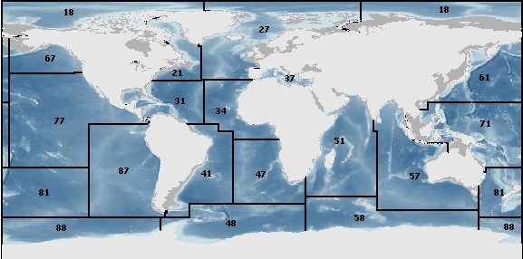
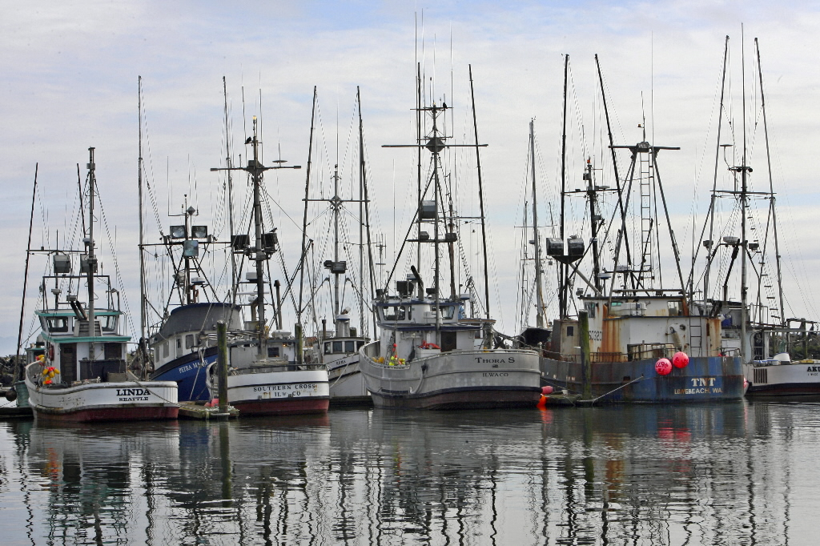
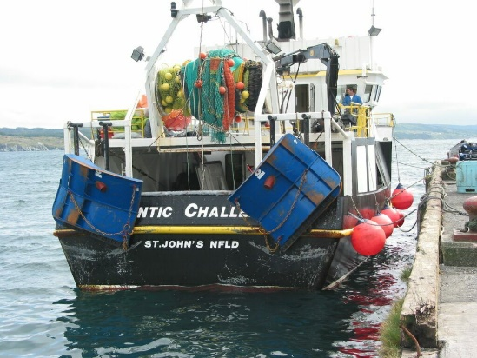
Life after 2019?

Slide 12
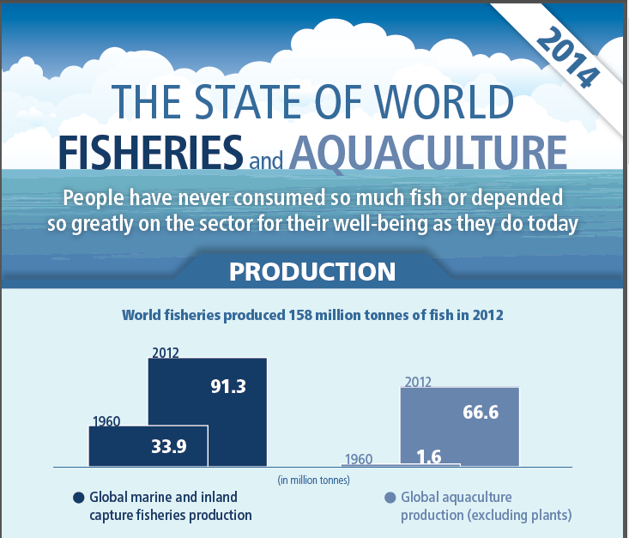

Slide 13
Post 2019:How to Prepare
The focus should be to finish on what can be done in the next 2 years as certain finished technologies and software could be desirable and attractive for use in new project proposals for post 2019.
As 2019 is approached, CRISP will need to get many of its scientific papers finished and submitted for publication, especially any that are co-authored with international collaborators to increase its international profile.

Slide 14
Post 2019:How to Prepare
Begin now to form new collaborative partnerships with some leading world institutes involved in technology development in both sustainable fishing and processing; Centre funds should be used in this preparation; for example other upcoming projects similar to EU-Horizon 2020 ( like MINOUW).
Promote CRISP’s technology and methodology for improving ecosystem studies, stock estimation and integrated ecosystem assessment and management-both nationally and internationally, for example using Deep Vision for demersal survey trawls and EK80 wideband echo sounder and SN90 fisheries sonars for pelagic schools

Slide 15
Post 2019:How to Prepare
Develop wider application of innovations in harvesting and processing for other world fisheries including those in developed and developing countries, i.e. small and mid-sized scale fisheries.
How is anyone going to afford the technology except for rich clients in “developed” countries? Consider reverse/disruptive innovation.

Slide 16
Post 2019:How to Prepare
Communicate clearly the impact on industrial participants – Make a difference, not just publications and relate to food security worldwide, as well as 35% waste in the value chain of seafood (FAO)
•Strategy regarding Norwegian vs international collaboration. FP9 begins in 2021, strategy for 2021-2024 being developed now by EU commission. How may “blue” funding be optimised and whom are the international allies?

Slide 17
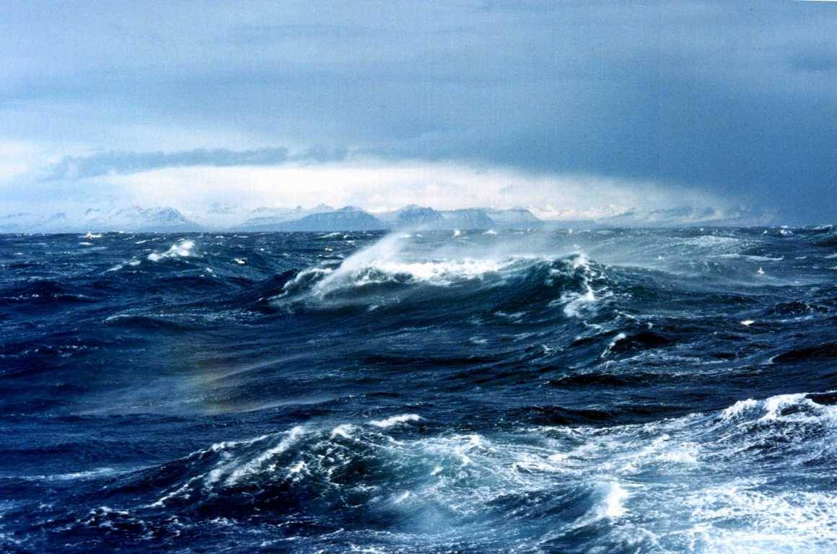
QUESTIONS?

